Slide 1

WORK REMOTELY?
WANT TO

Slide 2


WORK REMOTELY?
NEED
WANT TO

Slide 3

DATA COLLECTION
1
DATA ANALYSIS
2
VISUALIZATION
3
Web Scraping
Join and compare data

Slide 4
DATA COLLECTION
DATA COLLECTION
1
1
2
3
DATA ANALYSIS
REMOTE.IO
WE WORK REMOTELY
STACK OVERFLOW
2
VISUALIZATION
3
REMOTE JOBS / SONIA MELLER
WEB SCRAPING
1680 results
178 results
Remote
175 results
Non-remote
3750 results
FINAL REMOTE DATA FRAME
2033 RESULTS

Slide 5
FINDING TECHNOLOGIES
BUILD UP A GOLDEN SOURCE
DATA COLLECTION
1
DATA ANALYSIS
2
VISUALIZATION
3
REMOTE JOBS / SONIA MELLER
{
"remote_project": {
"technologies": {
"languages": [...],
"web_frameworks": [...],
"other_frameworks_libraries_tools": [...],
"databases": [...],
"platforms": [...],
"other_habilities": [...]
},
"level": [...]
}
}

Slide 6
DATA COLLECTION
1
VISUALIZATION
DATA ANALYSIS
2
PRESENTATION TITLE / YOUR NAME
VISUALIZATION
3

Slide 7
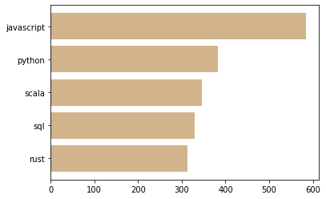
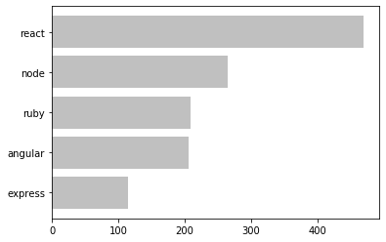
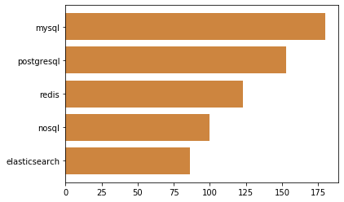
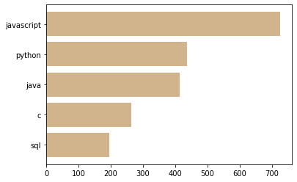
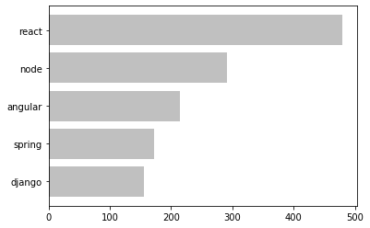
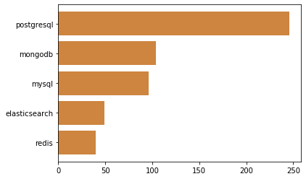
In-Demand Programming Technologies
LANGUAGES
FRAMEWORKS
DATABASES
REMOTE
REMOTE JOBS / SONIA MELLER
NON REMOTE

Slide 8
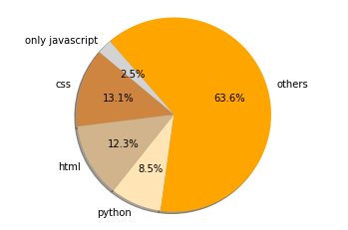
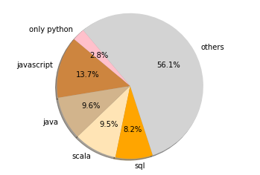
Related languages by language
JAVASCRIPT
PYTHON
REMOTE JOBS / SONIA MELLER

Slide 9
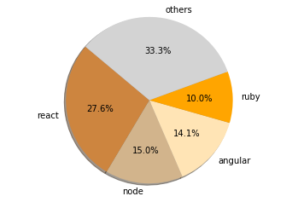
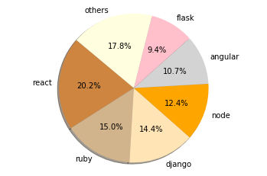
Related Frameworks by language
JAVASCRIPT
PYTHON
REMOTE JOBS / SONIA MELLER

Slide 10
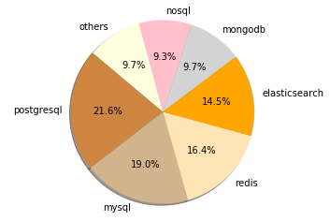
Related Databases by language
JAVASCRIPT
PYTHON
REMOTE JOBS / SONIA MELLER

Slide 11
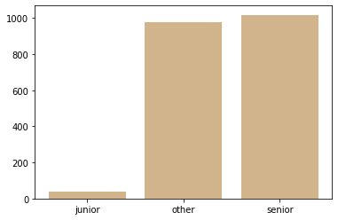
Remote job offers by level of experience
REMOTE JOBS / SONIA MELLER
JUNIOR
36 job offers

Slide 12
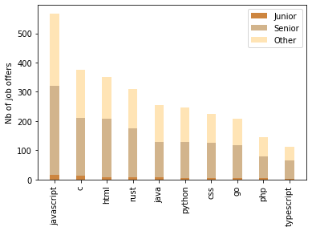
Remote job offers for top 10 languages
REMOTE JOBS / SONIA MELLER

Slide 13
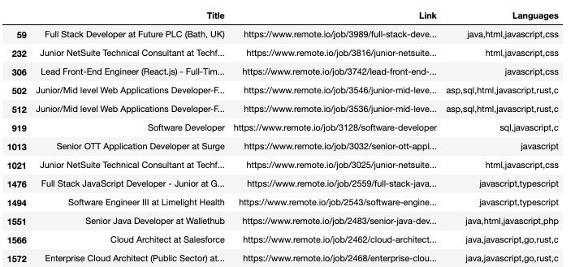
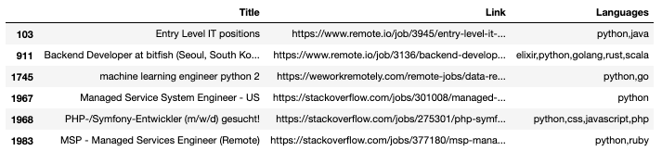
Junior Job offers by language
JAVASCRIPT
REMOTE JOBS / SONIA MELLER
PYTHON

Slide 14
LEARN JAVASCRIPT
REMOTE JOBS / SONIA MELLER
ENJOY THE QUARANTINE

Slide 15

MAIN CHALLENGES

Slide 16
1
2
DUPLICATES
SCRAPING TECHNOLOGIES
PRESENTATION TITLE / YOUR NAME
3
4
LANGUAGES & LOCATION
EXPERIENCE LEVEL
Job offers are probably duplicated in the different websites.
Selecting the required technologies since I got the whole text from the scraping.
Avoided analyzing languages and location required for each job position
Find better way to scrape it

Slide 17

THANKS!
Does anyone have any questions?

